Slide 1
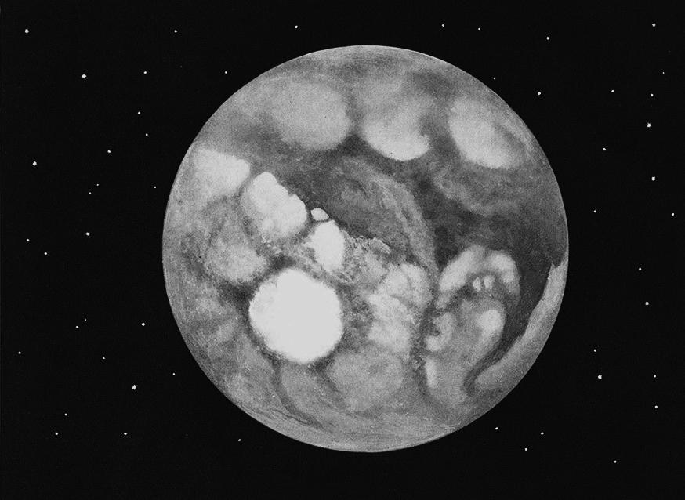
Arianrhod

Slide 2
Hack n’ Slash
Gods
Celts
Tarot
Action RPG
Isomorphic
Shapeshift
Life & Death
Elements

Slide 3
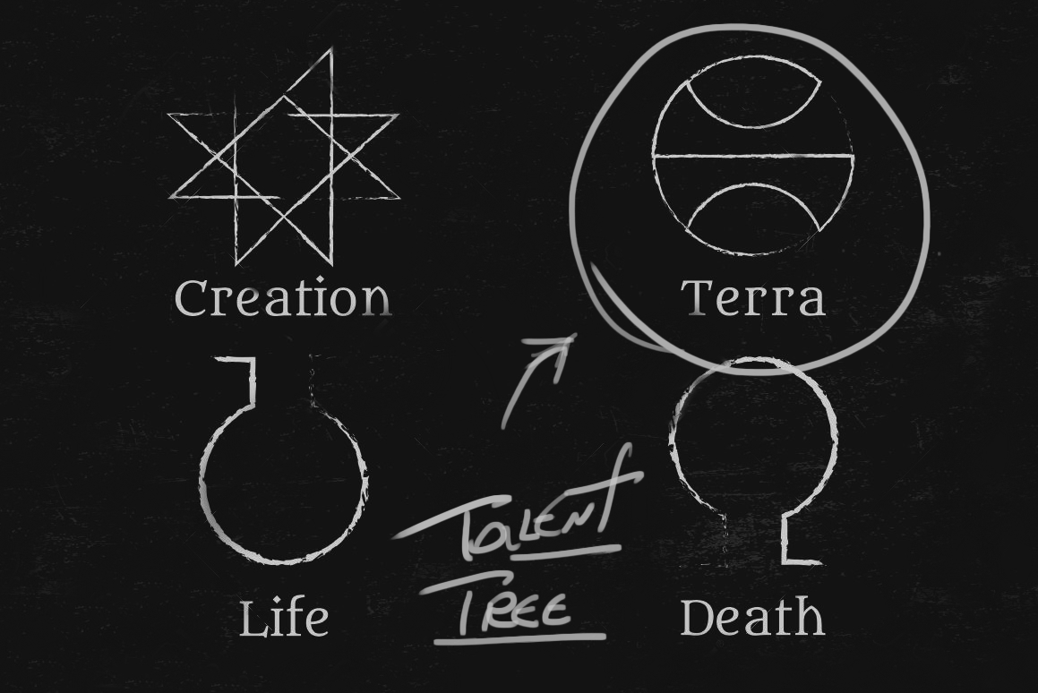

Slide 4
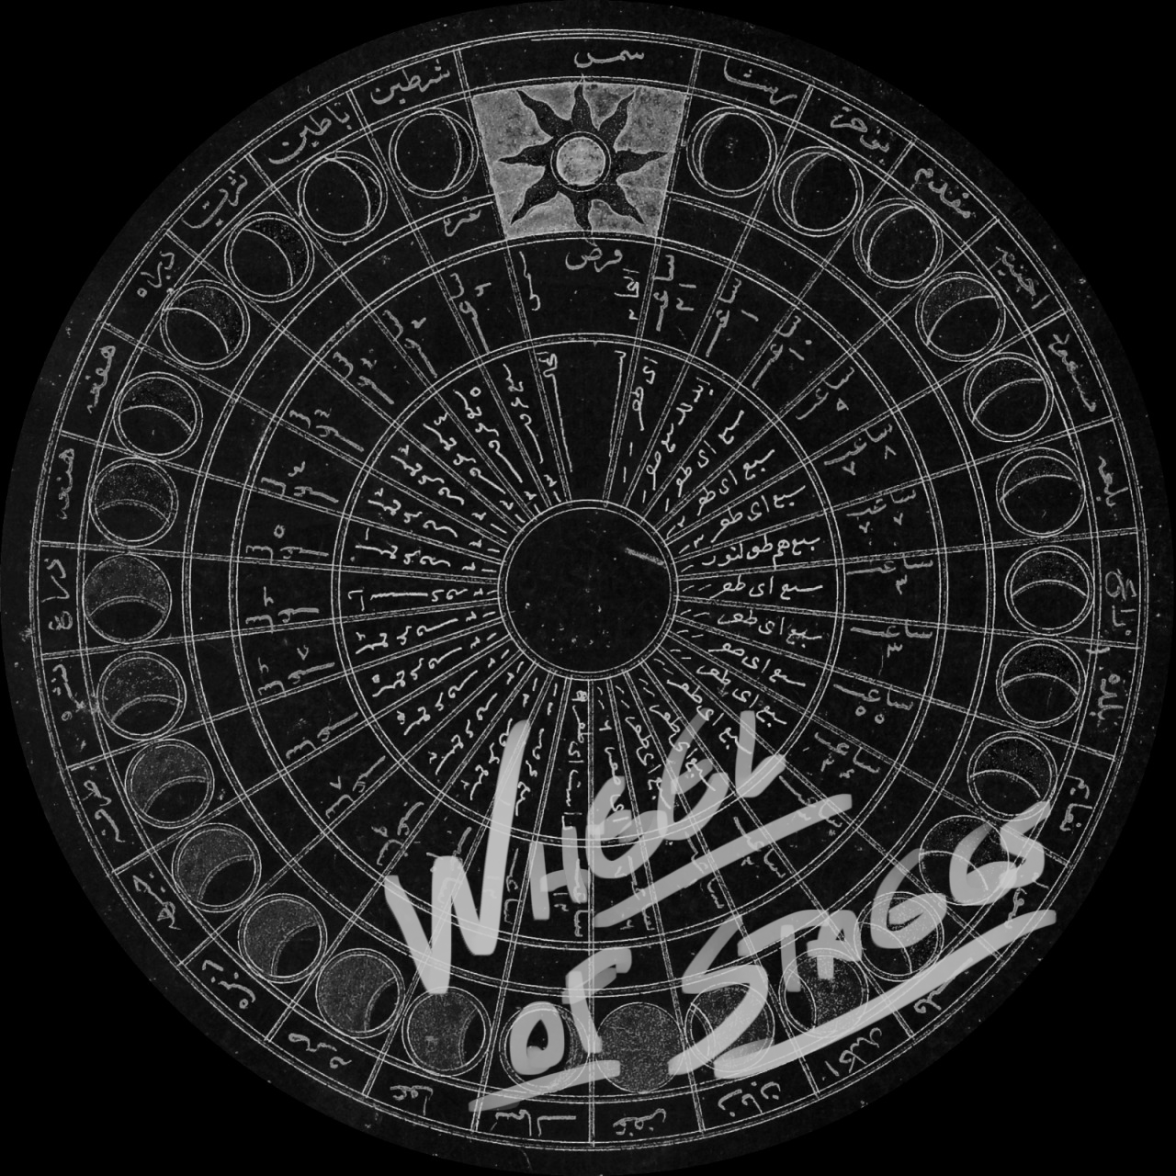

Slide 5
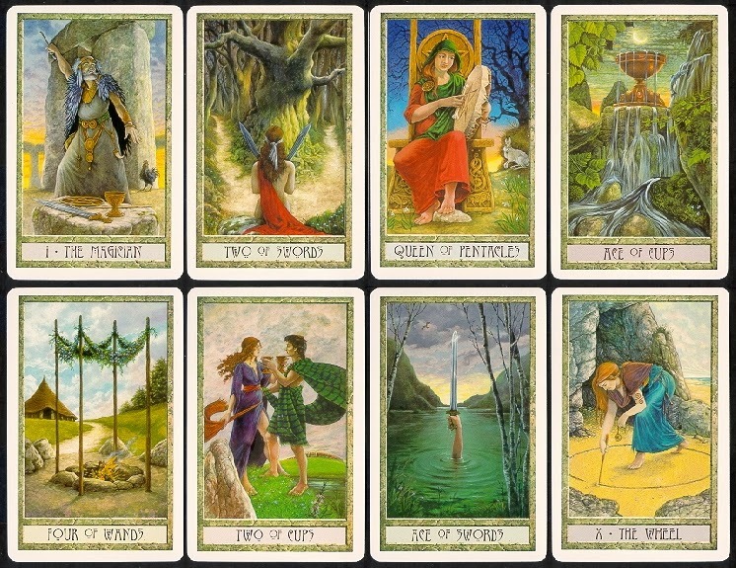

Slide 6
References

Slide 7
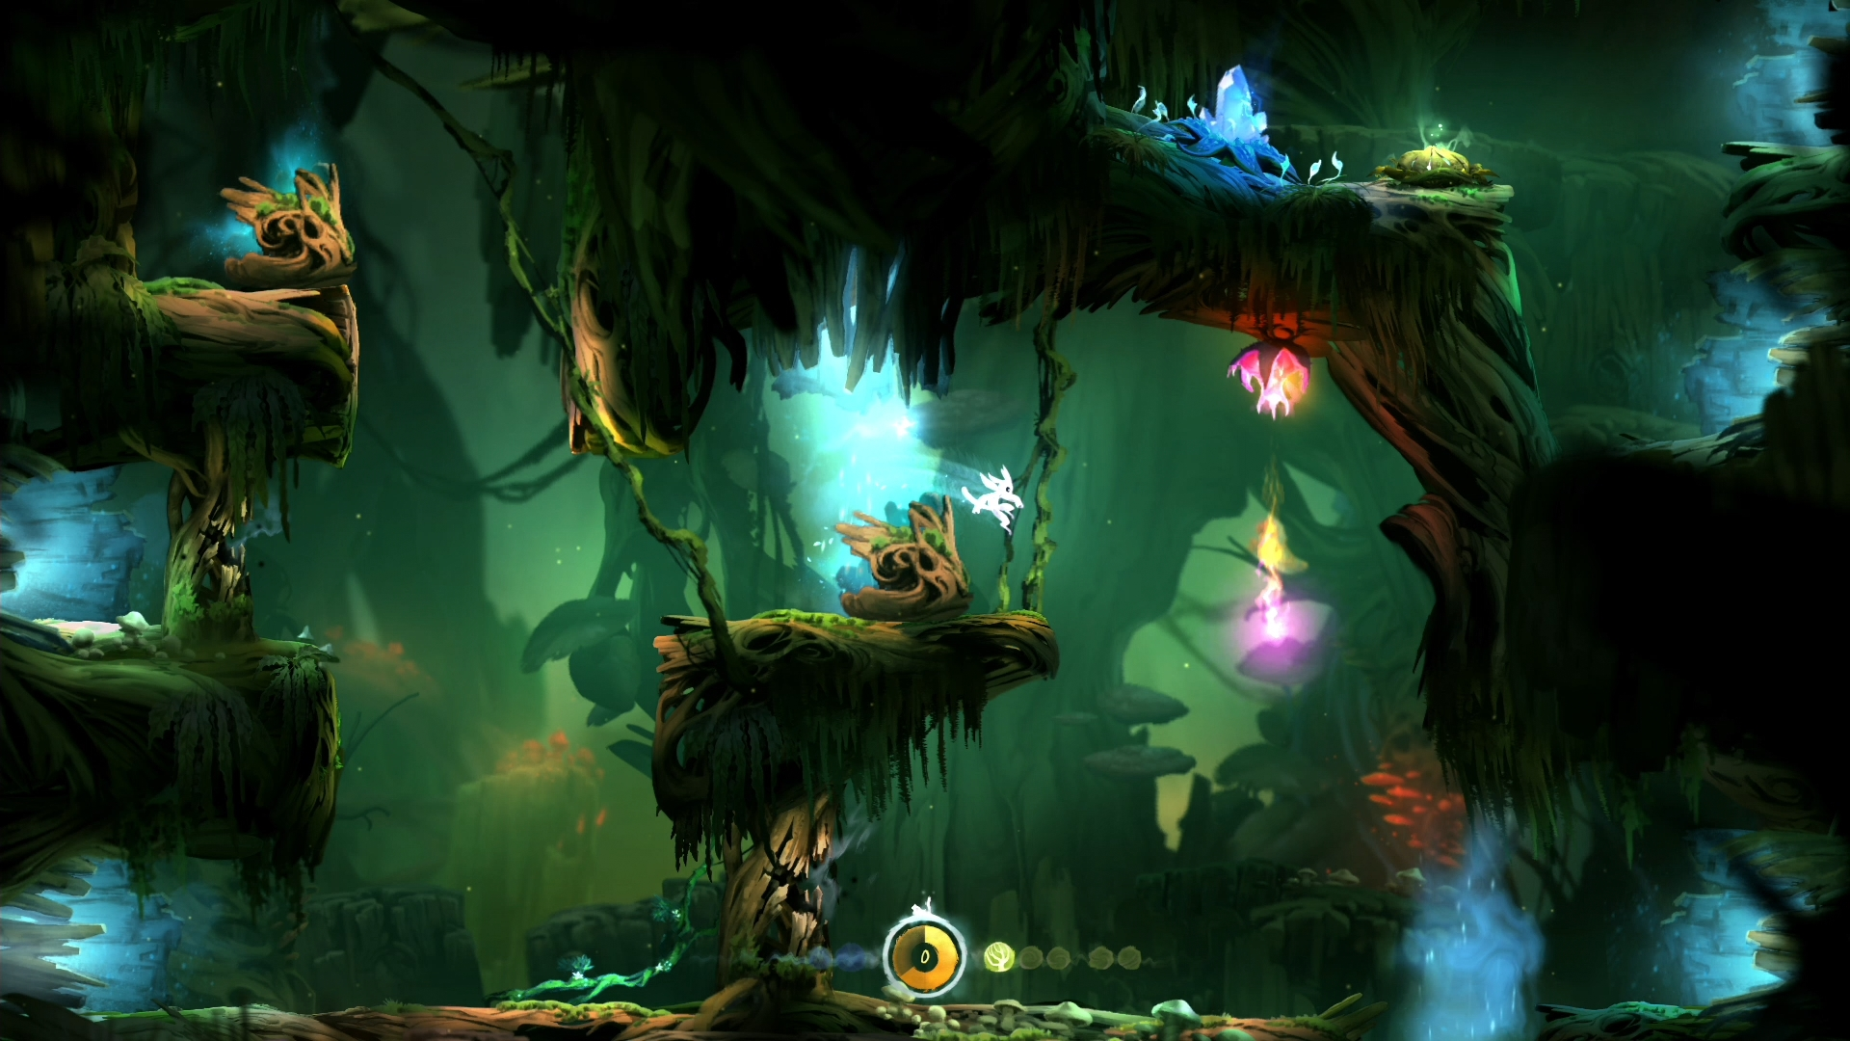
Ori and The Blind Forest

Slide 8
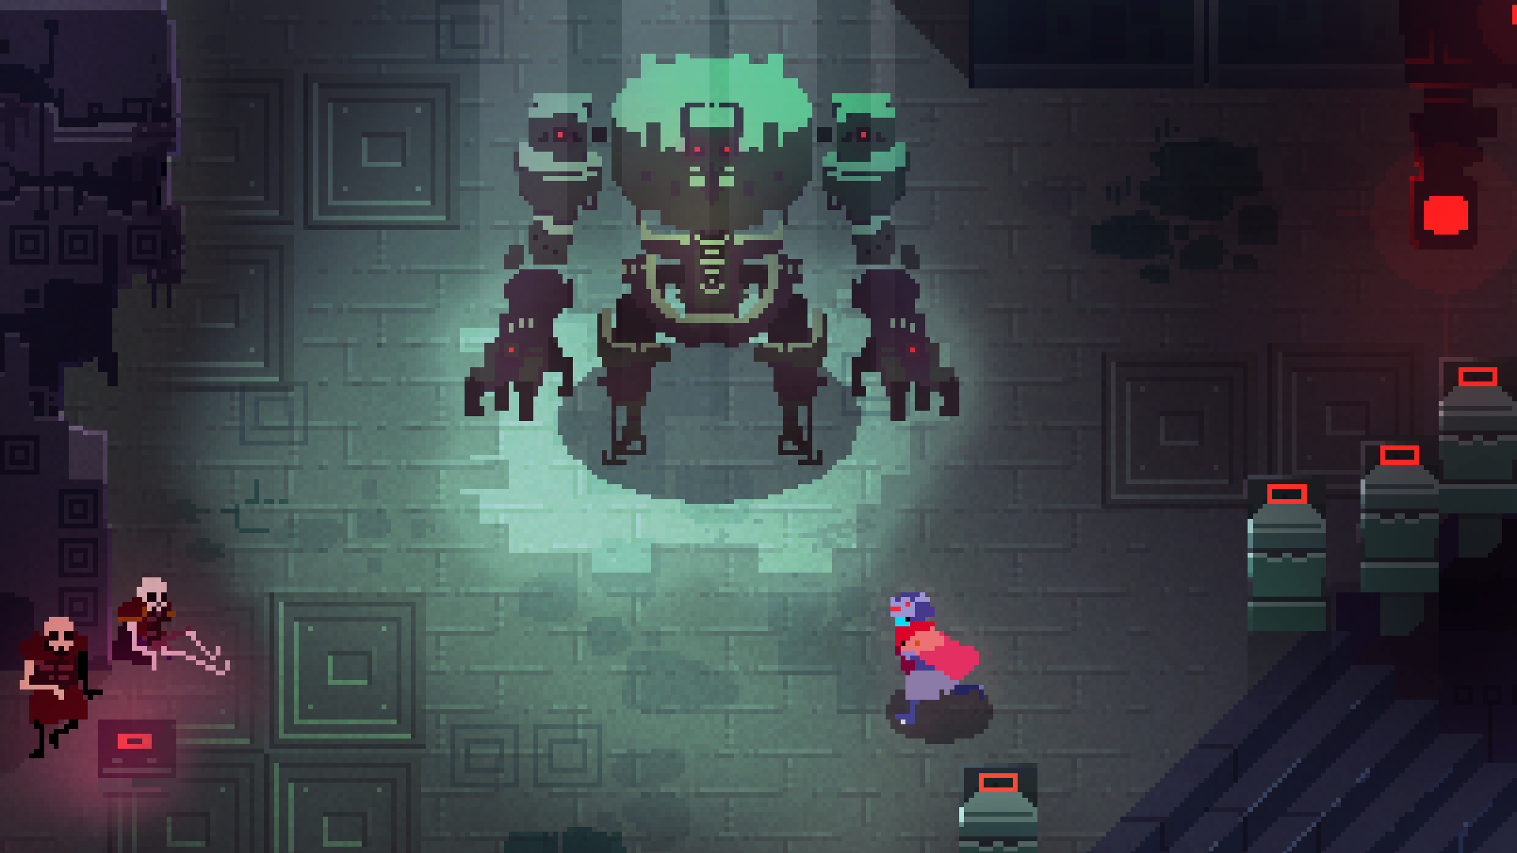
Hyper Light Drifter

Slide 9
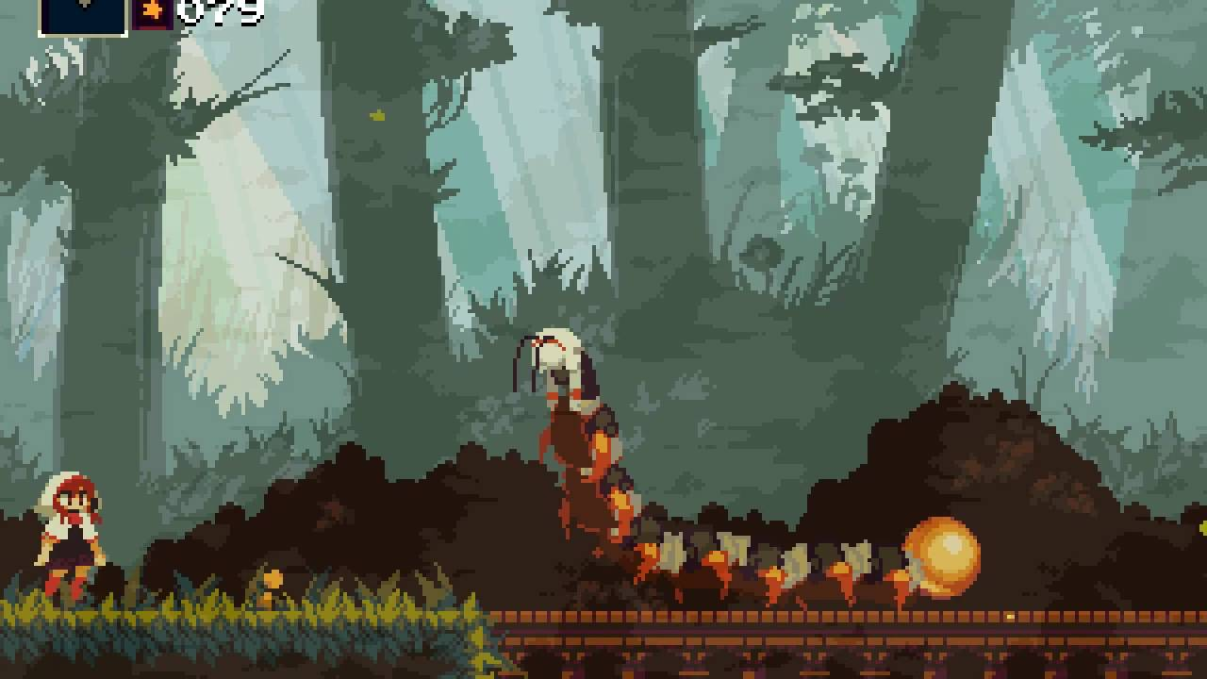
Momodora

Slide 10
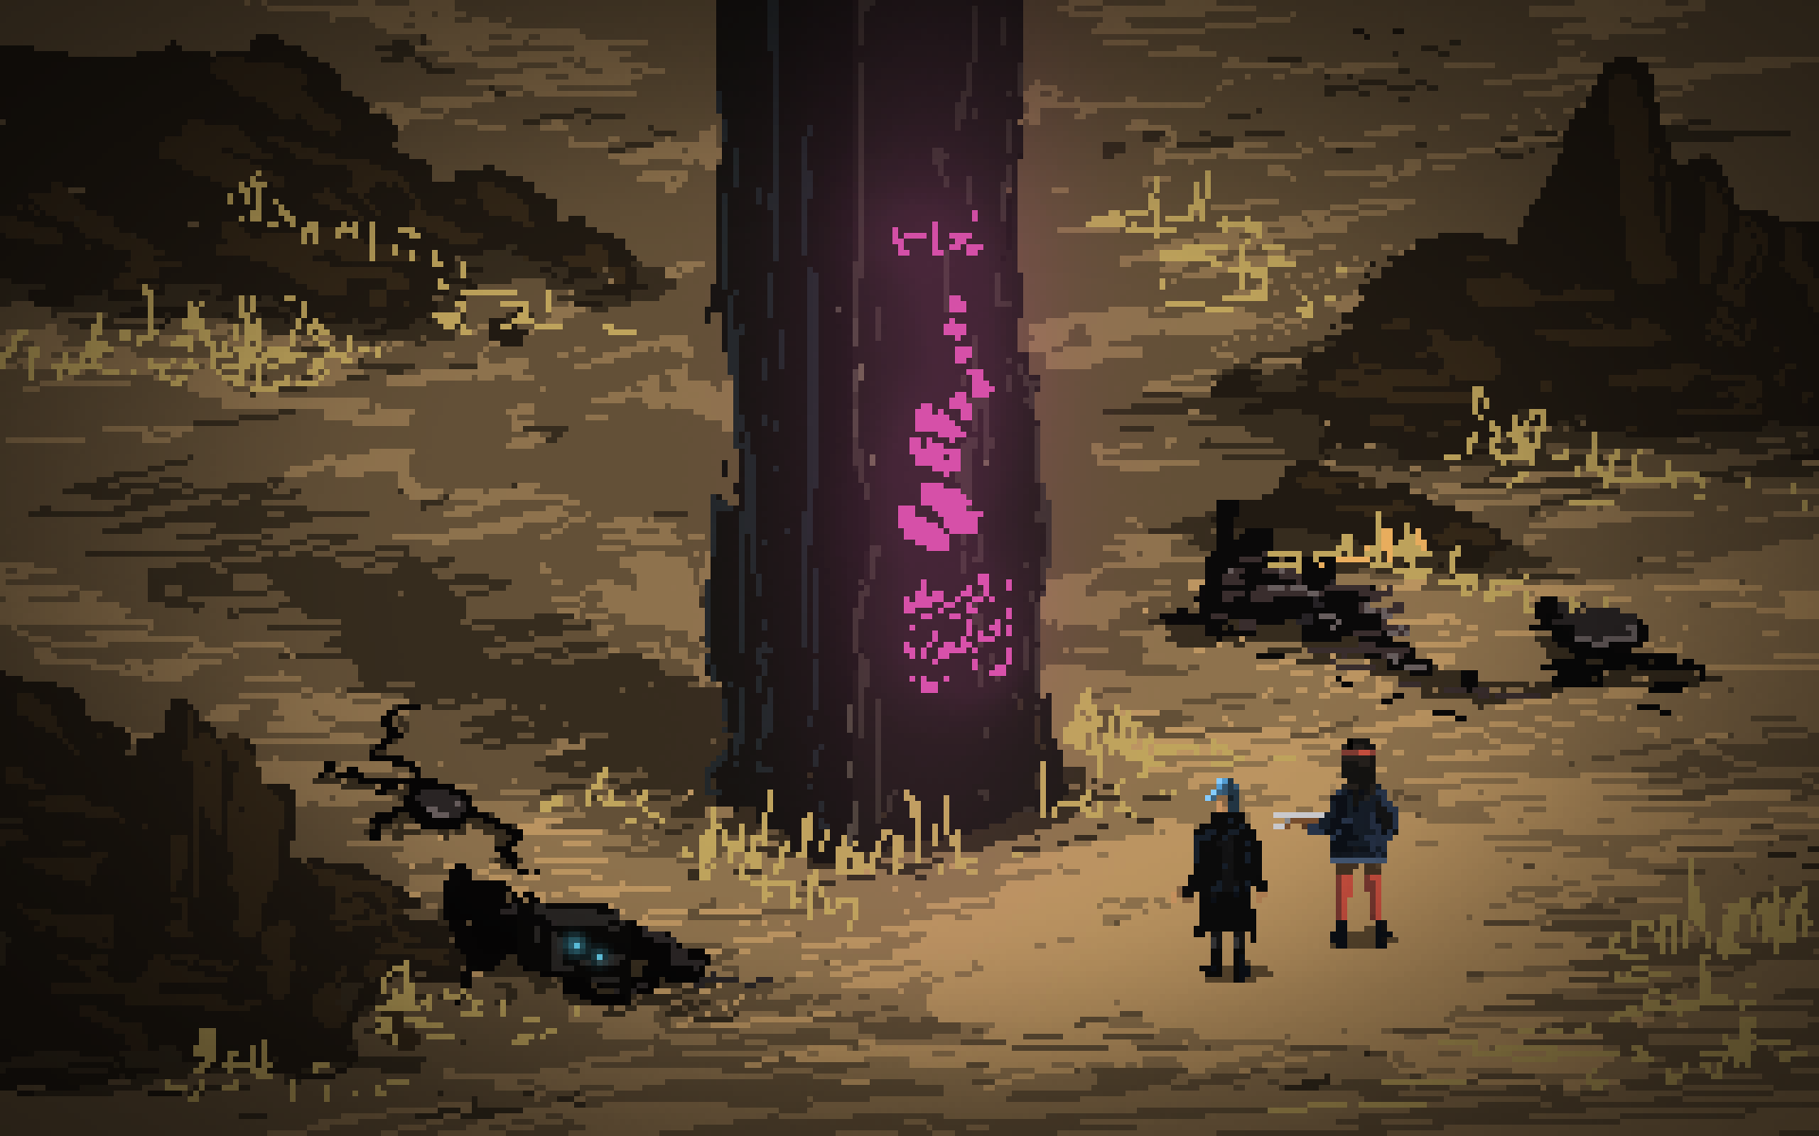
Death Trash

Slide 11
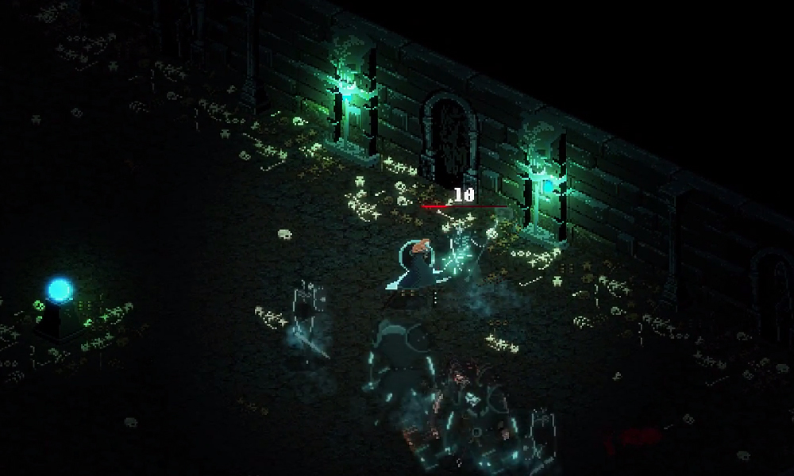
Eitr

Slide 12
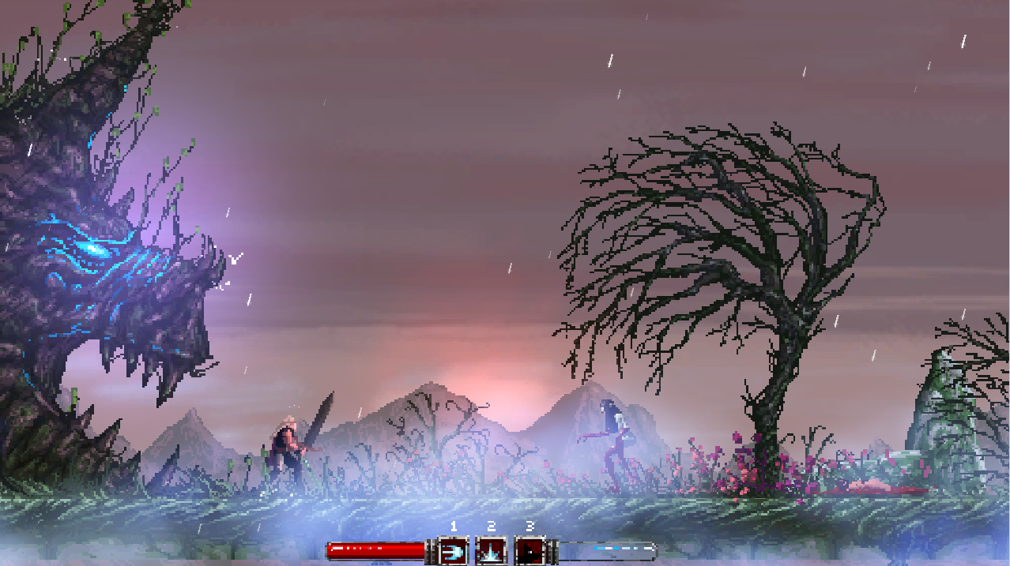
Slain!

Slide 13
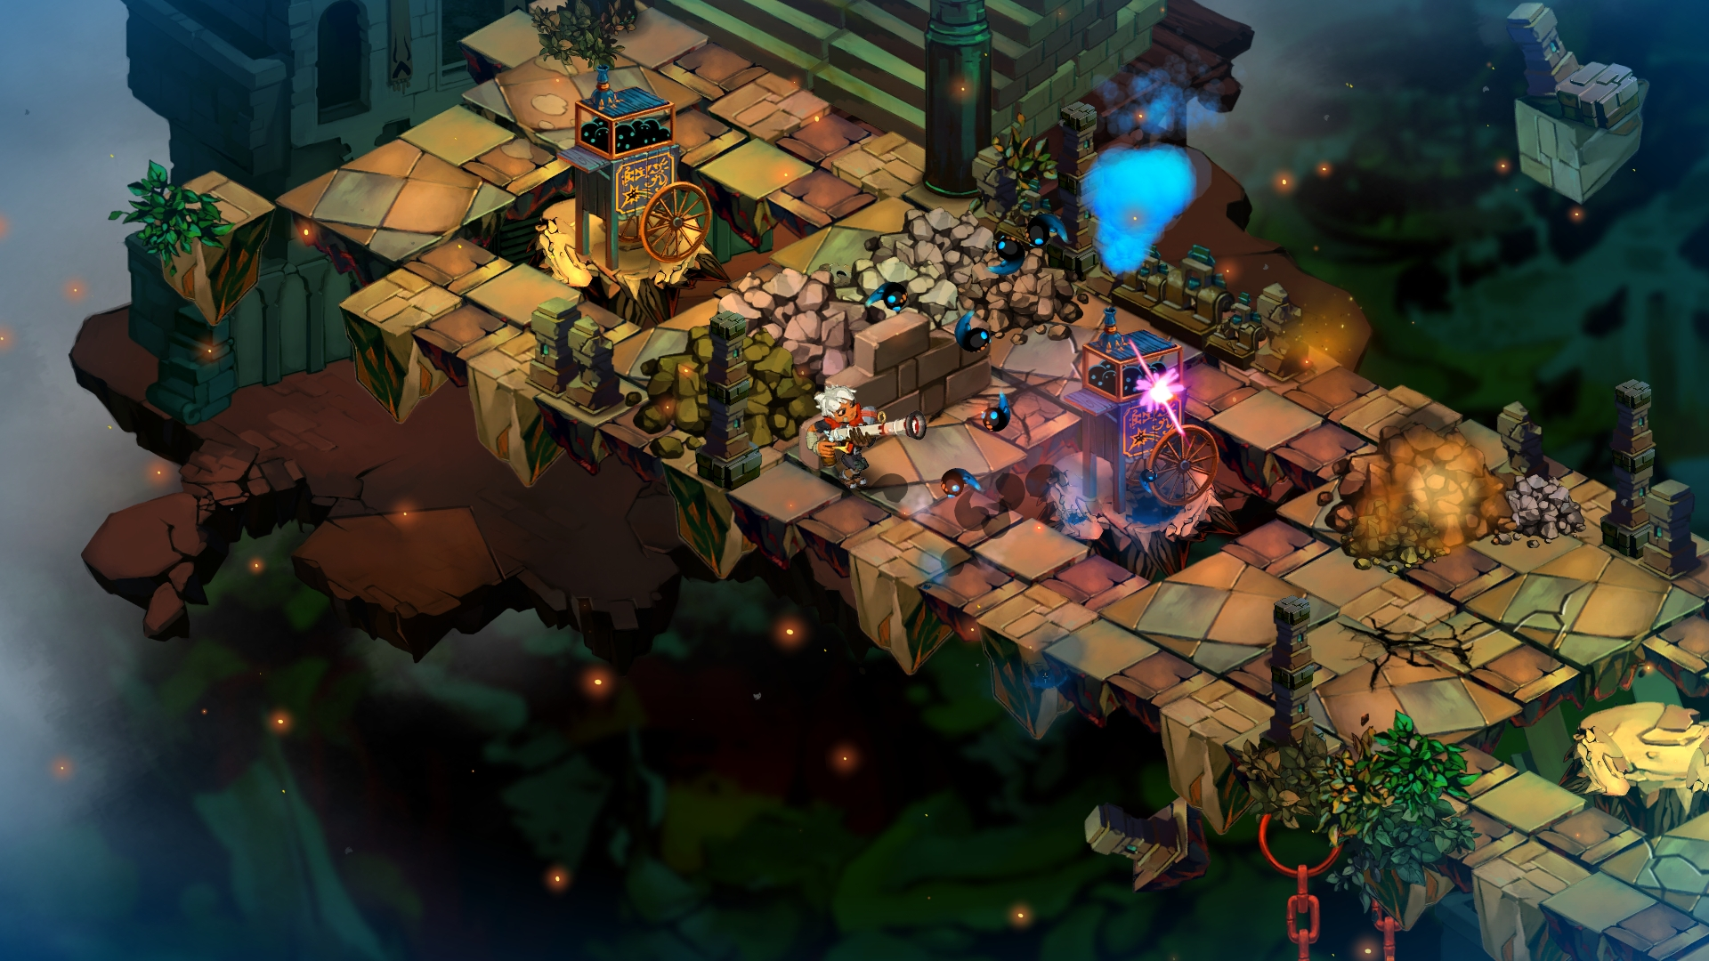
Bastion

Slide 14
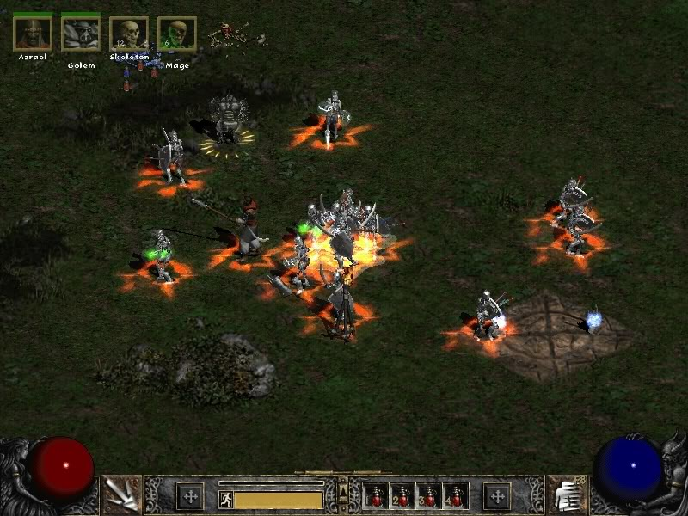
Diablo 2

